Slide 1
Using Technology to Map Environmental Vulnerabilities and Educate Local Stakeholders
FDEP Quarterly Coastal Resilience Forum
Sean Lahav, MPA & Angela Schedel, Ph.D., P.E.

Slide 2
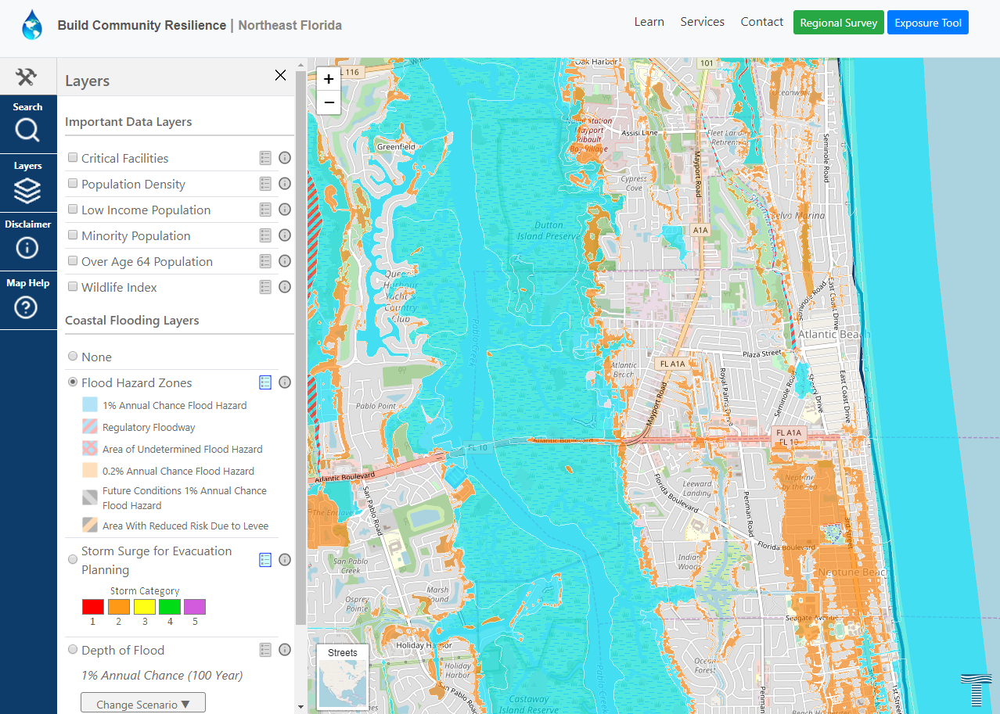
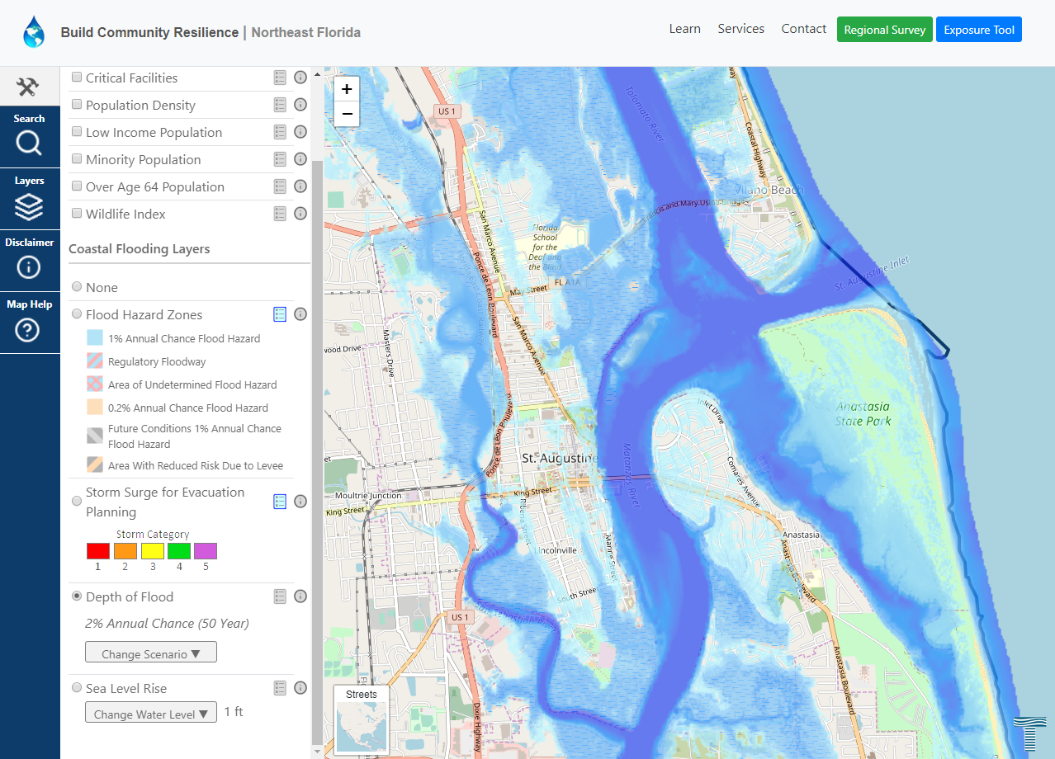
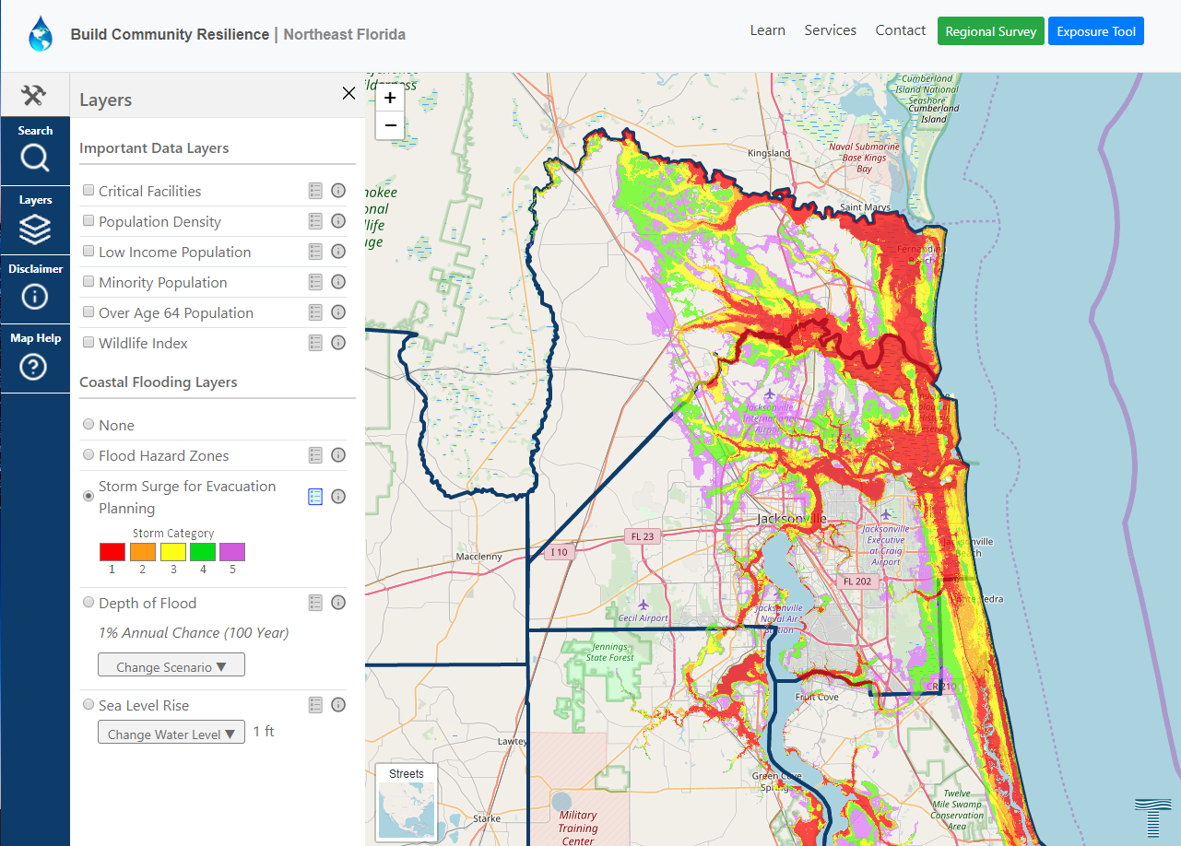
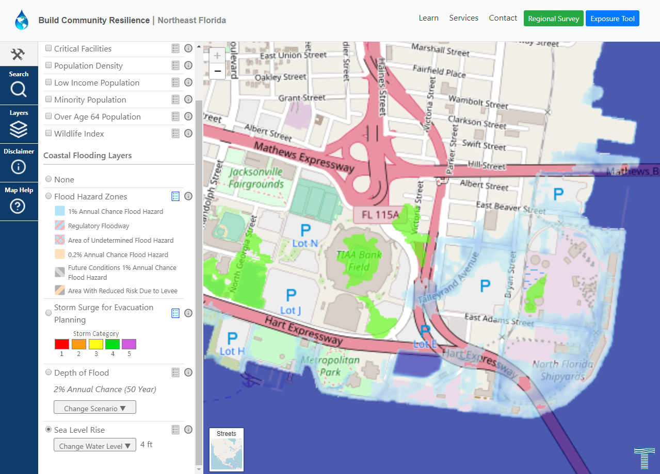
Regional Resilience Exposure Tool
Map tool that allows residents, business owners and governmental actors to determine if resources will be exposed to coastal flooding.
Coastal flood layers can be overlaid with other data layers such as population density, critical infrastructure, and priority environmental habitats.

Slide 3
www.buildcommunityresilience.com/northeastflorida/

Slide 4
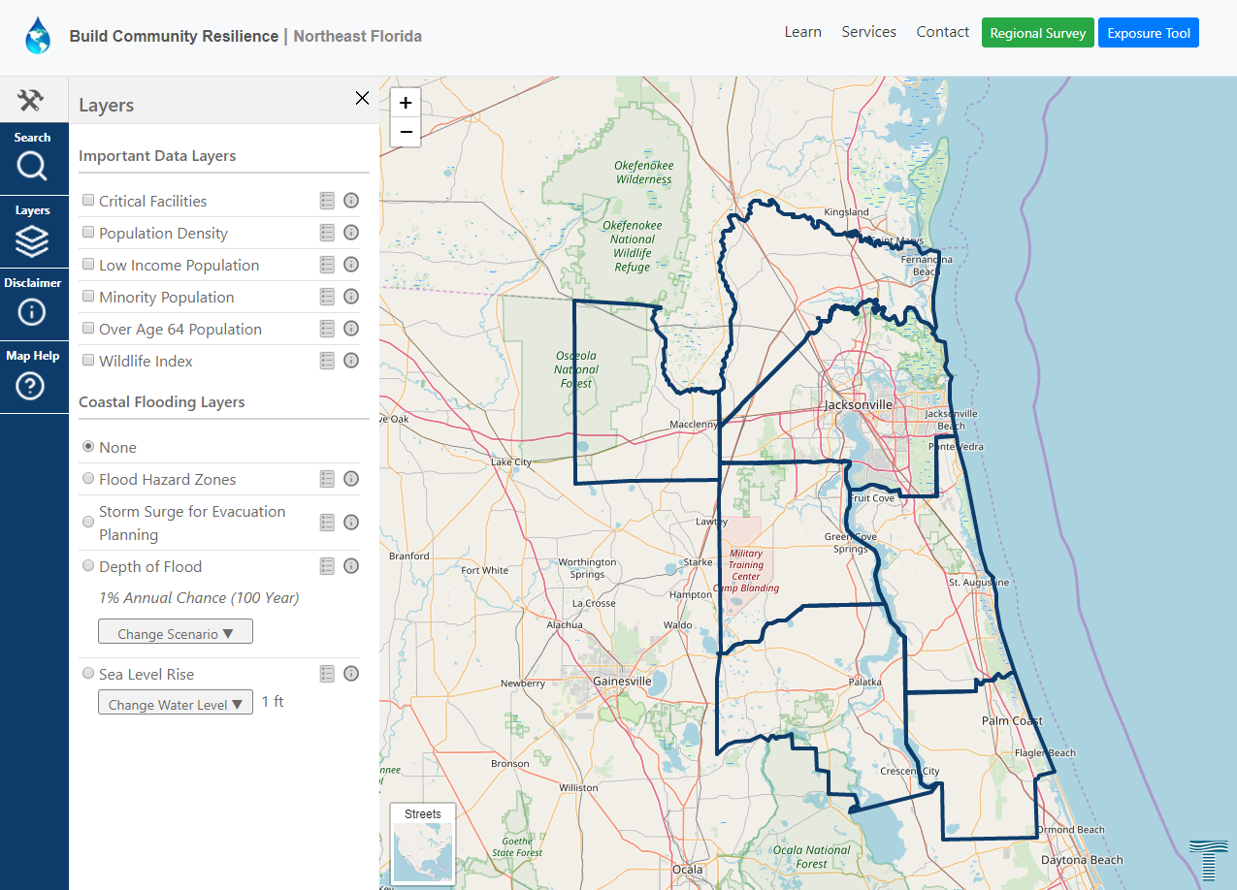

Slide 8
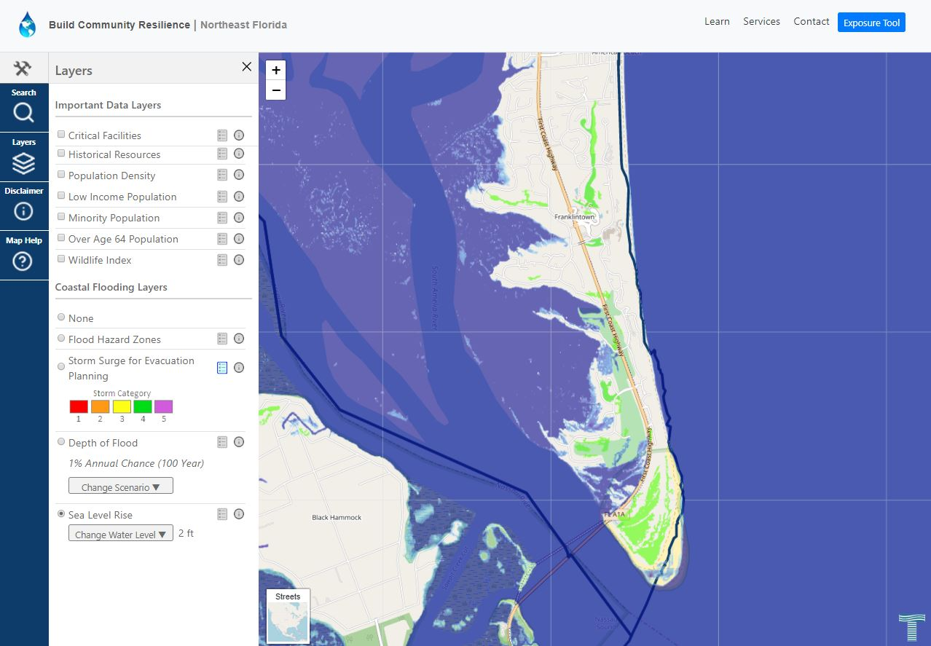

Slide 9
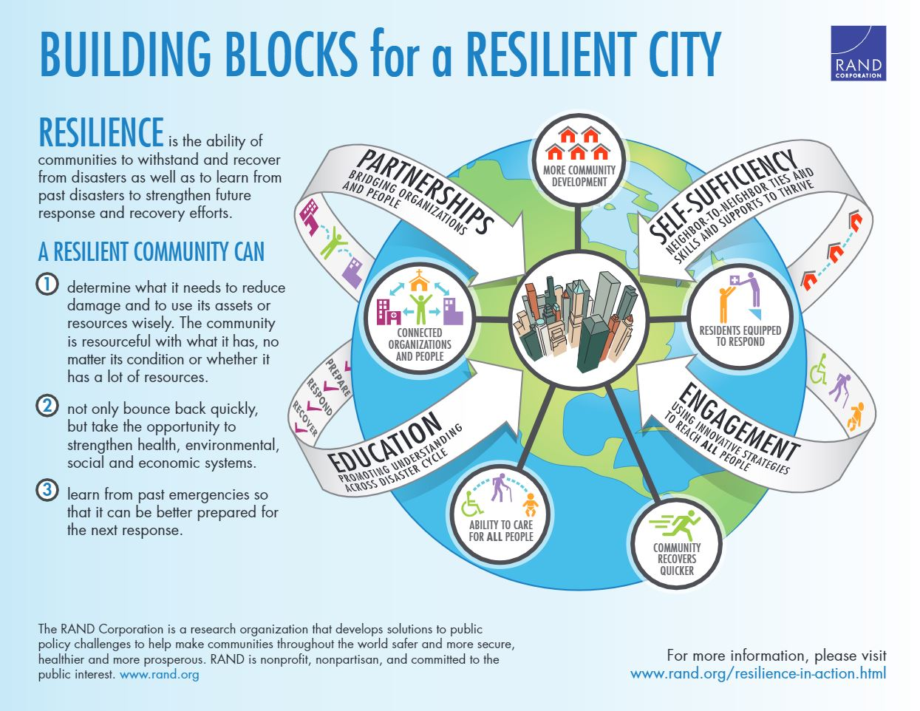

Slide 10
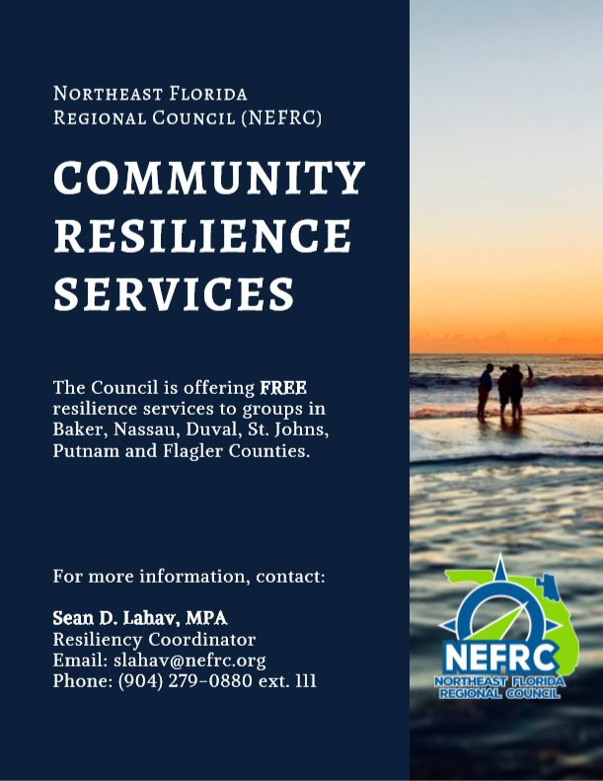

Slide 11
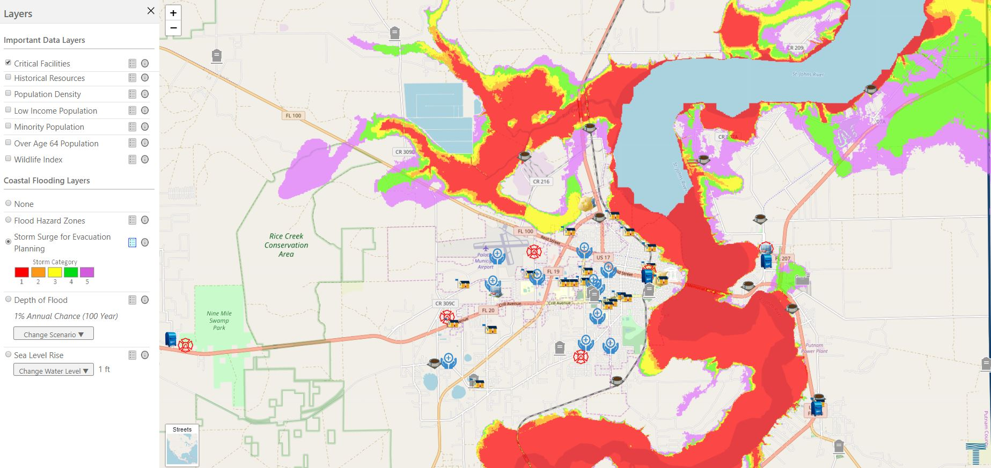

Slide 12
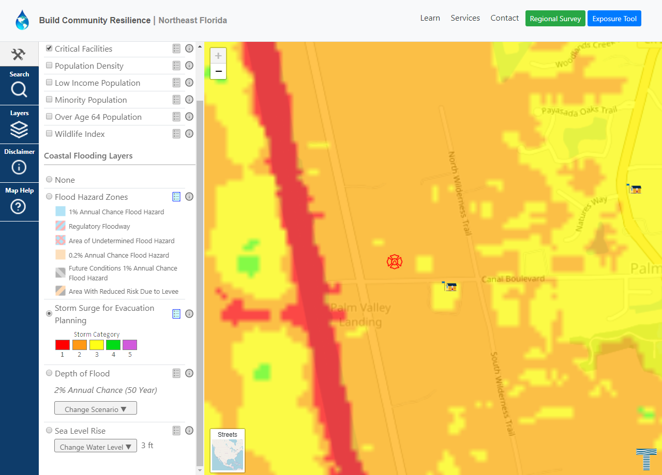

Slide 13
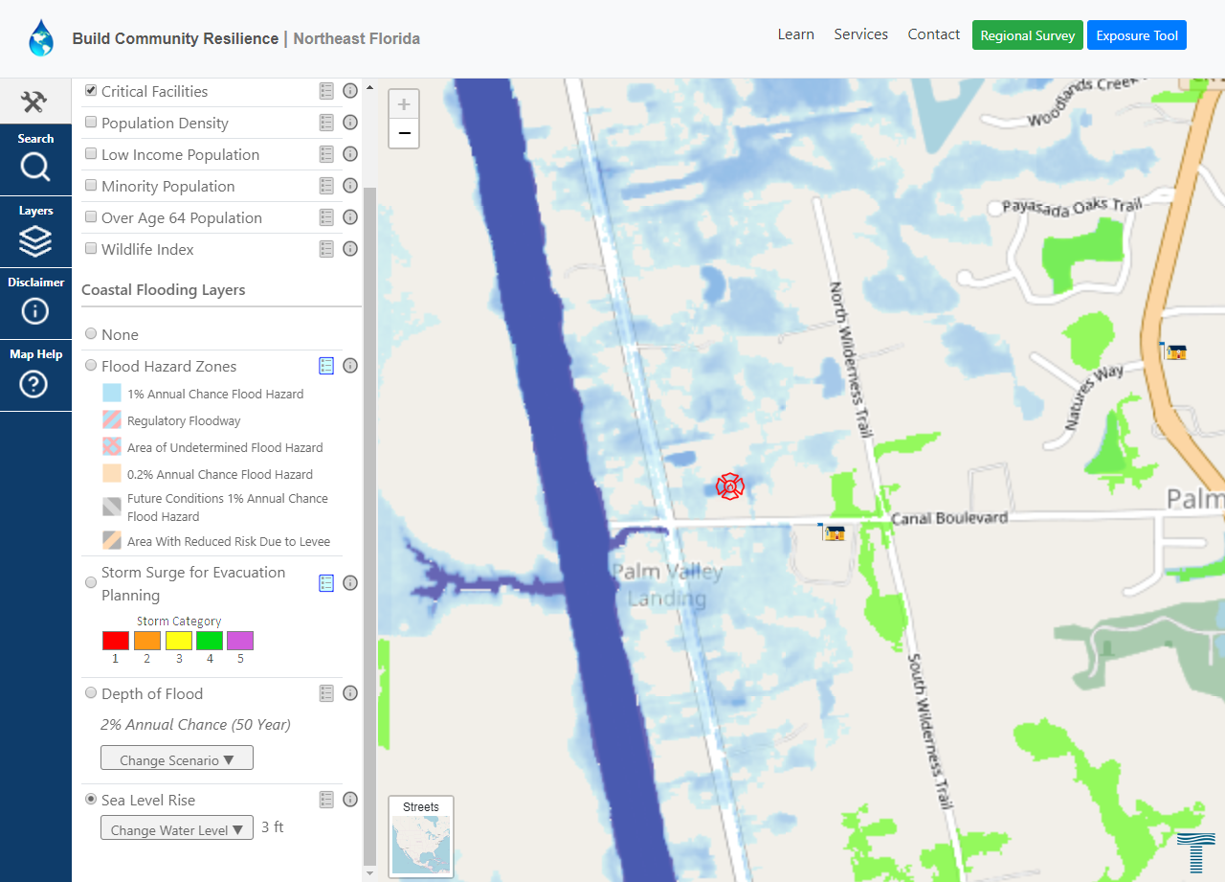

Slide 14
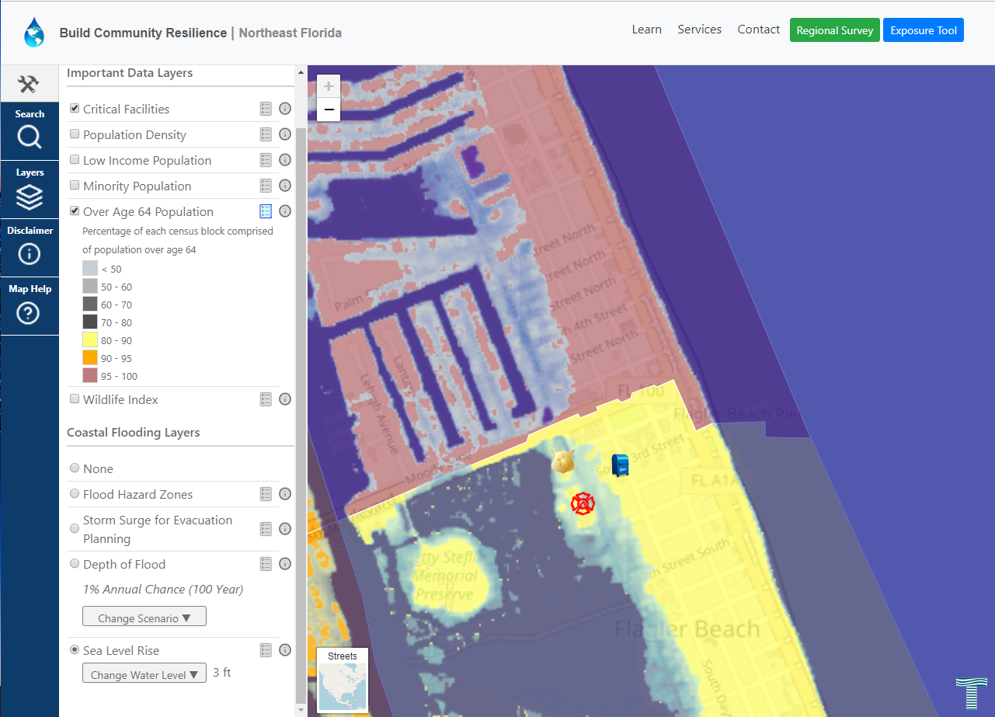

Slide 15
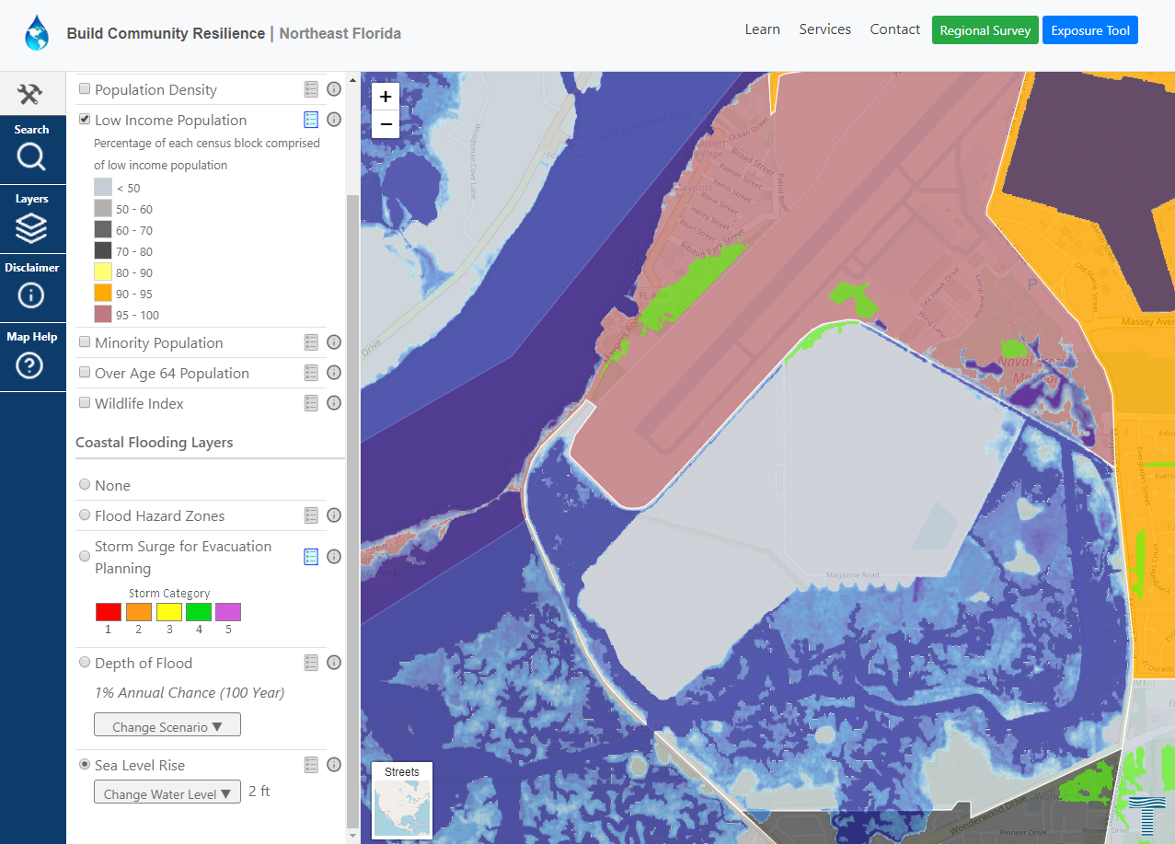

Slide 16
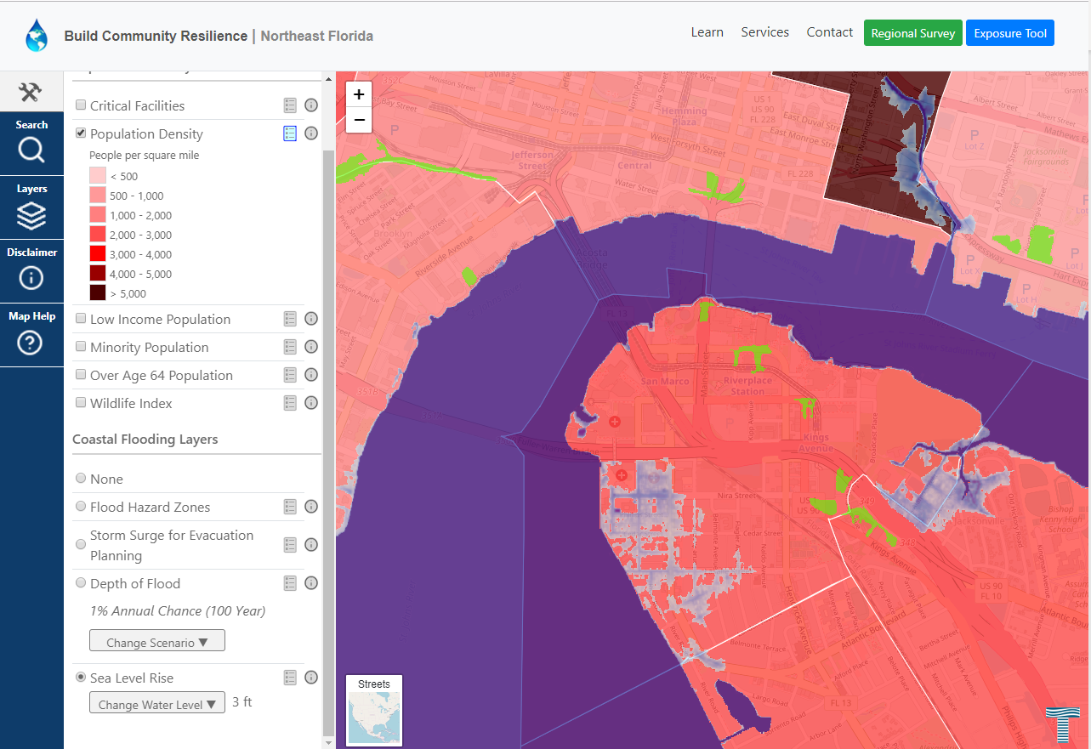

Slide 18
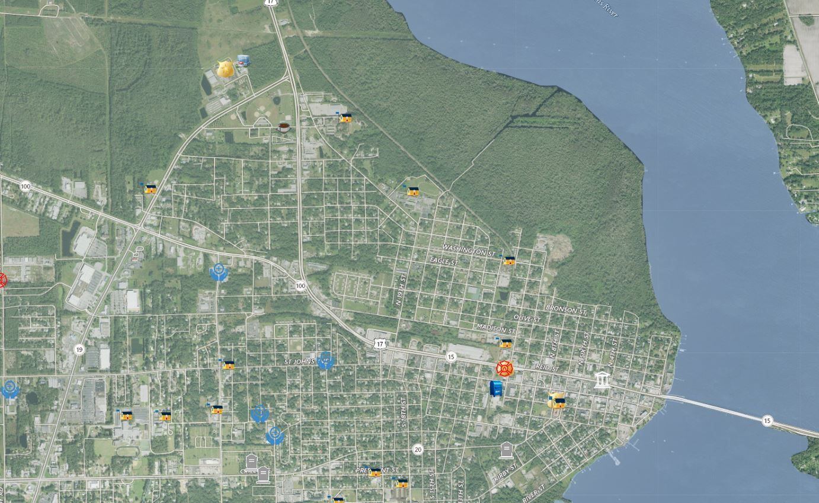

Slide 19
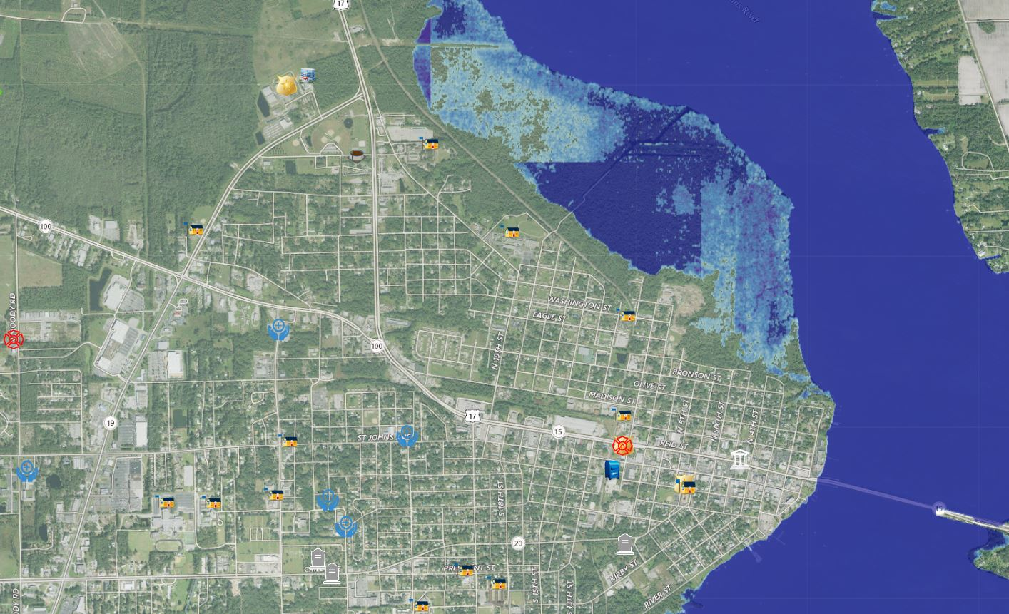

Slide 20
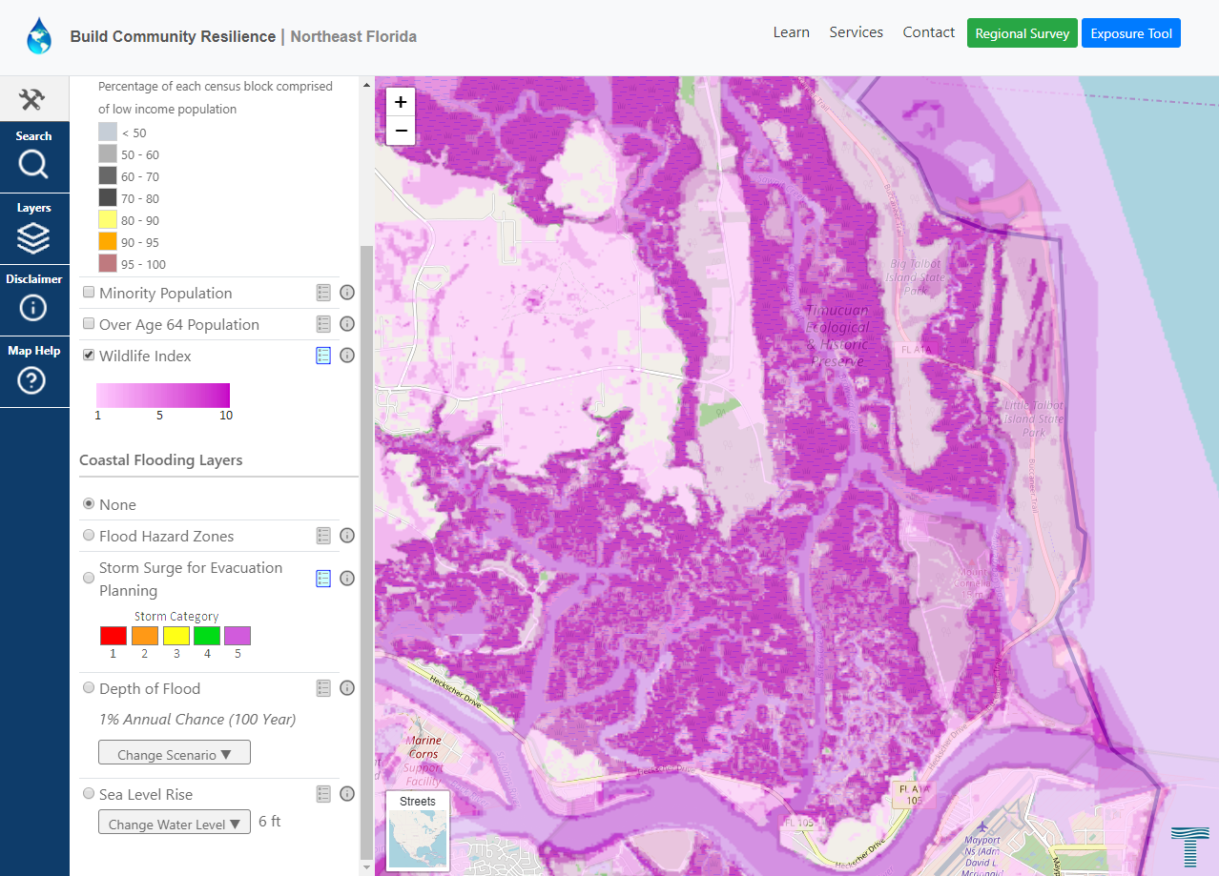

Slide 21
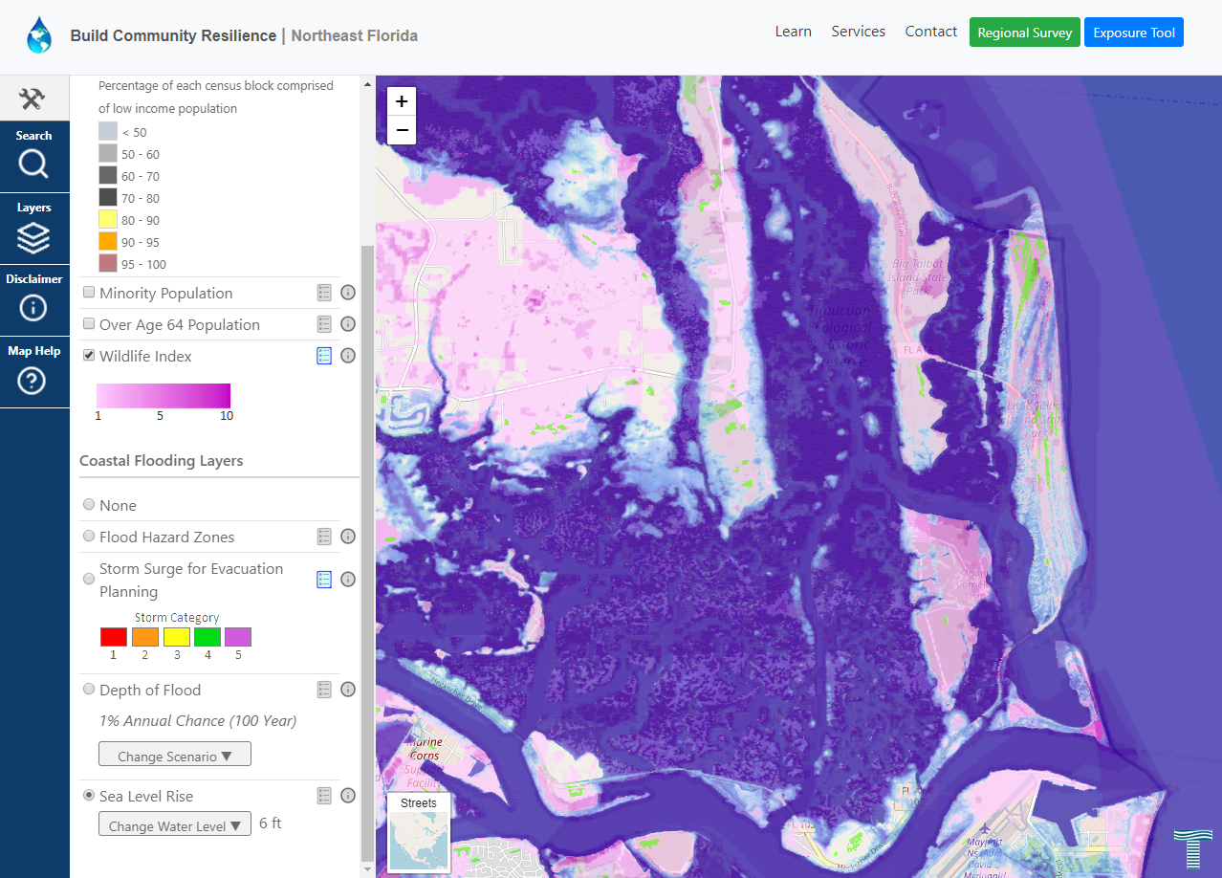

Slide 22
Moving Forward
Updating data layers
Using the tool for local government comprehensive planning
Private sector educational outreach
Local government public outreach
FEMA Community Rating System (CRS)

Slide 23
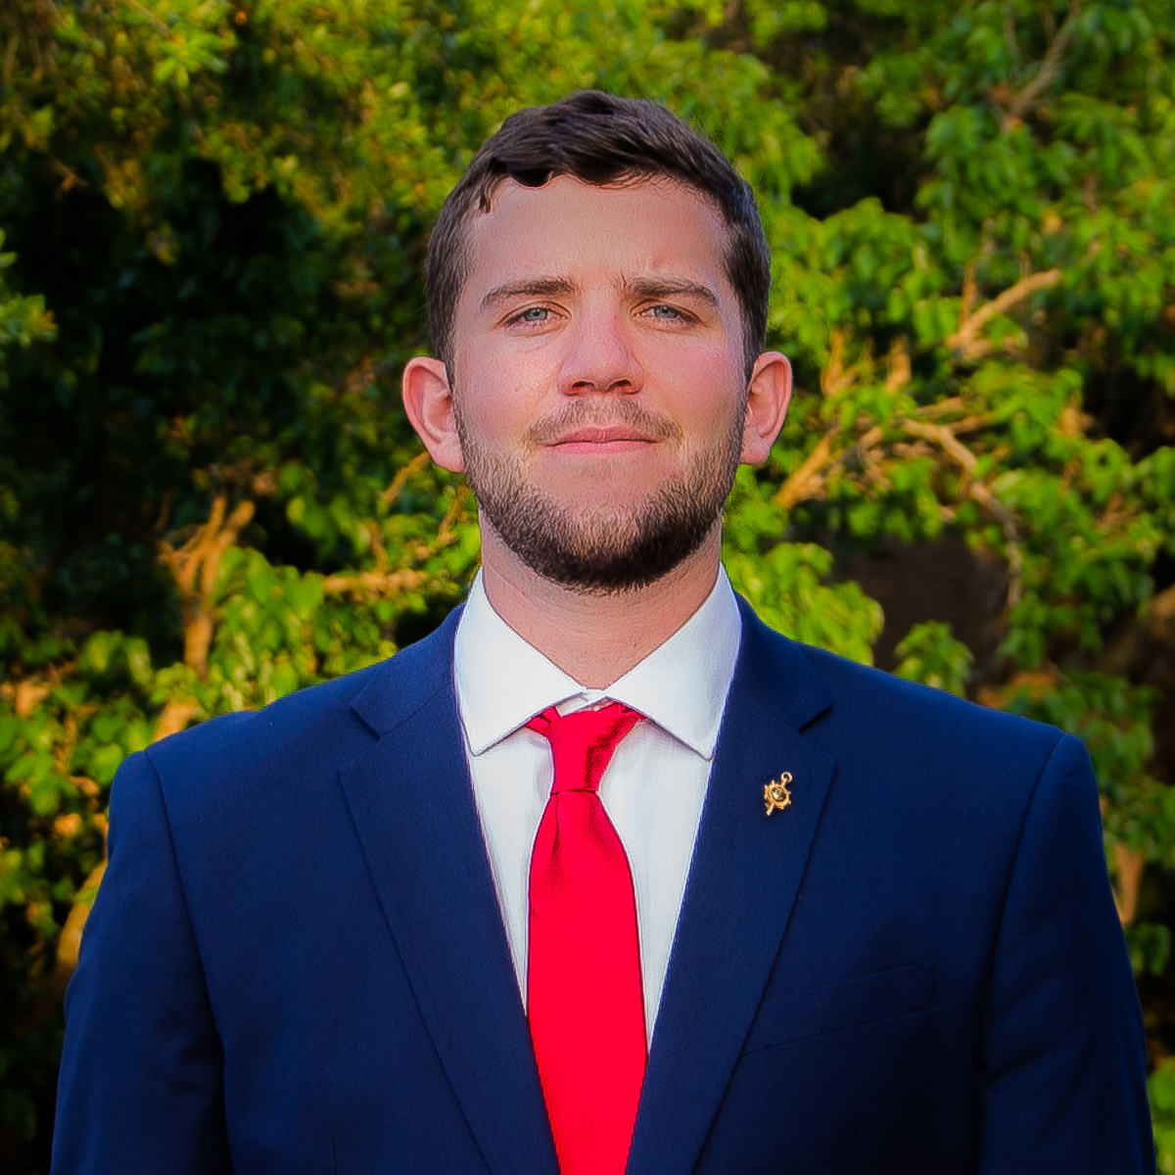
Sean D. Lahav, MPA
Resiliency Coordinator
Northeast Florida Regional Council
Email: slahav@nefrc.org
Phone: (904) 279-0880 ext. 111
Angela Schedel, Ph.D., P.E.
Director of Community Resiliency
Taylor Engineering
Email: aschedel@taylorengineering.com
Phone: (904) 731-7040

